Slide 1

Stock Market Trend Analysis
Predictive Analytics & Trading Signal Engine
3-Week Project | Financial Services | Global Investment Partners

Slide 2

MarketPulse Analytics: The Challenge
Organization Profile
The Problem
Global Investment Partners manages £500M across 10,000+ monthly trades with sophisticated quant strategies. Yet despite scale and expertise, systematic underperformance persists.
8% annual underperformance and £3.5M in slippage losses signal missed opportunities and inefficient execution across market regimes.
Mission: Deploy data-driven market analysis and predictive modeling to enhance trading performance and systematize decision-making.

Slide 3

Business Challenge: Seven Critical Gaps
1
Manual Analysis Delays Execution
Reliance on technical analysis creates lag in market entry/exit, missing intraday momentum shifts and trend reversals that algorithms could capture in milliseconds.
2
No Real-Time Multi-Asset Correlation
Portfolio managers lack systematic correlation processing across asset classes, preventing hedging optimization and sector rotation strategies.
3
Inadequate Risk Management Infrastructure
High-volatility periods trigger unnecessary drawdowns due to reactive rather than predictive risk positioning and volatility regime blindness.
4
Compliance & Auditability Gaps
Manual monitoring of 50+ stocks lacks data-driven justification for trades, creating compliance friction and hindering performance review audits.

Slide 4
Seven Strategic Objectives
Trend Classification Engine
Advanced Feature Pipeline
Build models distinguishing uptrend, downtrend, and sideways regimes with confidence scoring.
Engineer 40+ technical indicators capturing momentum, volatility, and mean reversion signals.
Rigorous Backtesting Framework
Real-Time Prediction API
Implement time-series validation with walk-forward analysis and financial performance metrics.
Deploy FastAPI endpoint serving live predictions integrated with market data streams.
MLOps Infrastructure
Interactive Dashboard
Build model versioning, experiment tracking, and monitoring pipeline for production governance.
Create portfolio manager interface visualizing predictions, signals, and performance metrics in real-time.

Slide 5
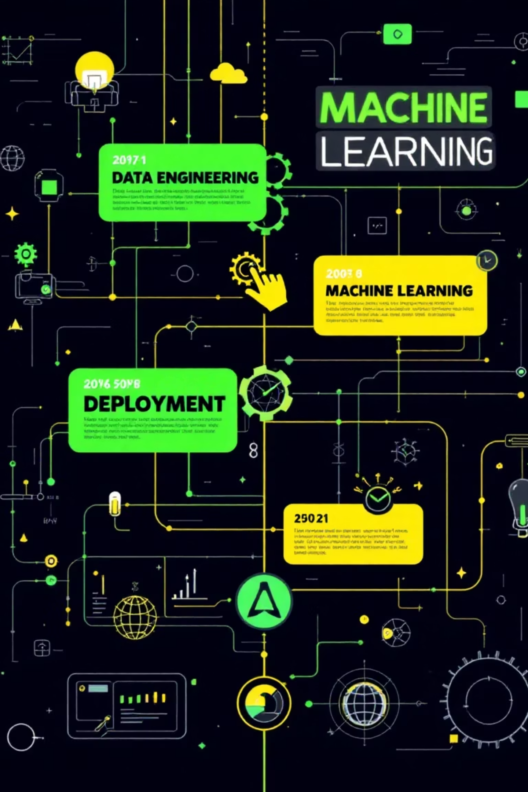

Three-Week Development Roadmap
Week 1: Data & Features
Collect 3+ years OHLCV data across 20 stocks (5 sectors). Engineer 40+ technical indicators via TA-Lib. Comprehensive EDA reveals price patterns and correlation structures.
Week 2: Models & Validation
Train XGBoost, Random Forest, LightGBM classifiers with time-series cross-validation. Backtest with financial metrics: annual returns, win rates, maximum drawdown.
Week 3: MLOps & Deployment
Deploy MLflow for experiment tracking and model registry. Launch FastAPI prediction service in Docker. Build Streamlit dashboard with real-time signal visualization.

Slide 6
Technical Architecture: Data to Decisions
01
02
03
Data Ingestion & Storage
Feature Engineering Pipeline
ML Ensemble
yfinance API → PostgreSQL database with Redis caching for sub-second feature retrieval.
TA-Lib and pandas generate 40+ technical indicators including momentum, volatility, and mean-reversion signals.
XGBoost, Random Forest, LightGBM classifiers combined via voting ensemble for robust trend predictions.
04
05
MLOps & Governance
Production Serving
MLflow tracks experiments, versions models, logs performance. GitHub Actions CI/CD automates testing and deployment.
FastAPI endpoint with Docker containerization delivers <200ms predictions. Streamlit dashboard presents signals and metrics.

Slide 7
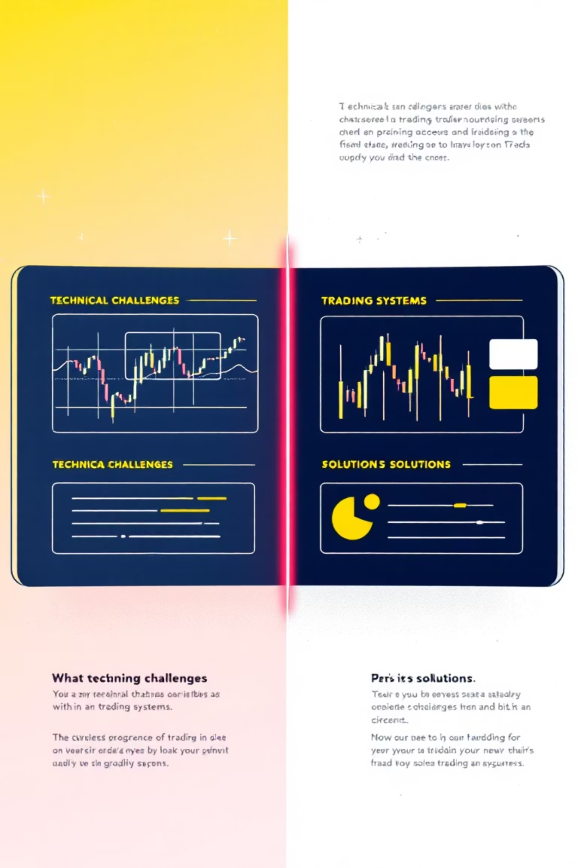
Solving Technical Hurdles
Challenge 1: Time-Series Data Leakage
Challenge 2: Market Regime Shifts
Risk: Future information contaminating training data inflates performance metrics.
Risk: Models trained on bull markets fail in downturns or high-volatility periods.
Solution: Include multiple market cycles. Add volatility regime features. Monitor prediction drift.
Solution: TimeSeriesSplit with strict temporal ordering, no shuffling. Walk-forward validation simulates real trading.
Challenge 3: Class Imbalance
Challenge 4: Production Latency
Risk: Uptrend/downtrend may dominate; sideways movements underrepresented.
Risk: Slow inference delays trading signals, reducing profitability.
Solution: SMOTE oversampling and class weight adjustment ensure balanced learning.
Solution: Pre-compute features. Optimize models. Redis caching enables <200ms response times.

Slide 8

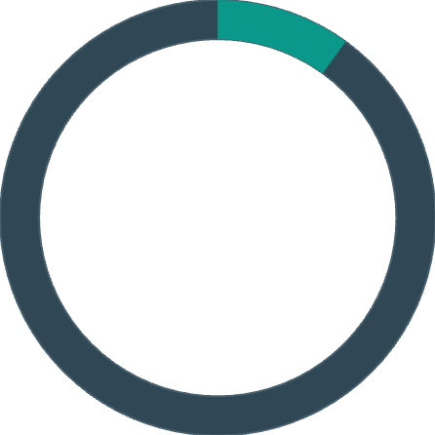

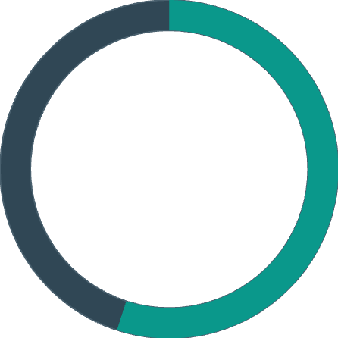

Success Metrics: Defining Excellence
>65%
>10%
Model Accuracy
Annual Return
Classification accuracy threshold. F1-Score target: >0.60 for balanced precision-recall.
Backtesting benchmark. Maximum drawdown constrained to <20% during market stress.
>70%
>55%
High-Confidence Signals
Win Rate
Prediction accuracy when model confidence exceeds 80 threshold for actionable signals.
Percentage of profitable trades. Combined with return and drawdown metrics, defines strategy quality.
<200ms
<10%
API Latency
Prediction Drift
Response time target. 99% uptime SLA for production serving reliability.
Model performance stability week-over-week. Excessive drift triggers retraining alert.

Slide 9

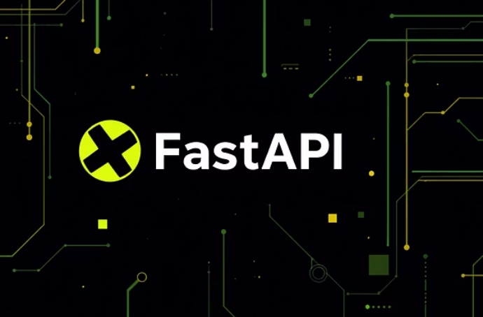




Deliverables & Production Stack
Core Outputs
Trend classification ensemble (XGBoost, Random Forest, LightGBM) with confidence scoring
Feature engineering pipeline: 40+ technical indicators, automated daily updates
Backtesting framework with financial metrics (returns, drawdown, win rate reporting)
Real-time FastAPI prediction service integrated with live market data
PostgreSQL database containing 3+ years stock history across 20 securities
MLflow tracking system with full model versioning and experiment history
Interactive Streamlit dashboard for portfolio managers and traders
Docker containerized deployment with GitHub Actions CI/CD pipeline
Technology Stack: Python | scikit-learn | XGBoost | LightGBM | MLflow | FastAPI | PostgreSQL | Docker | Streamlit

Slide 10
Learning Outcomes & Business Impact
Technical Mastery
Business Excellence
Financial time-series modeling and technical analysis design
Quantitative trading strategy development and backtesting
Ensemble classification methods and hyperparameter optimization
Risk assessment using drawdown and volatility analysis
Feature engineering for trading signal extraction
Financial performance metrics calculation and interpretation
MLOps infrastructure: tracking, versioning, monitoring
Production API deployment and compliance-ready audit trails
Expected Business Impact
Systematic Trend Detection
Reduced Slippage & Drawdown
Replace manual analysis with data-driven classification, capturing market reversals in real-time.
Predictive positioning minimizes unnecessary losses during regime shifts; targets <20% max drawdown.
Compliant Decision-Making
Scalable Infrastructure
Every trade backed by quantitative signal with full audit trail for regulatory confidence.
MLOps pipeline automates retraining and monitoring; production-ready for enterprise deployment.

